Slide 1


Slide 2

Gender-Based-Comparative-Analysis-of-Heart-Disease-Prediction-Models
Group No: 29
Muhammad Umair Akram Butt
Course Professor: Veselka Boeva

Slide 3
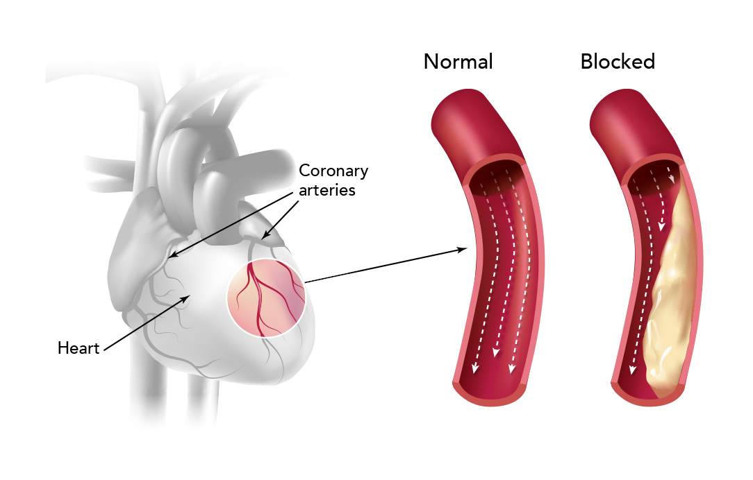
Background
Cardiovascular Disease - heart's arteries narrow or become blocked.
19.8 million deaths in 2022 - 32% of all global deaths [1].
Timely prediction - preventive interventions.
[1] https://www.who.int/news-room/fact-sheets/detail/cardiovascular-diseases-(cvds)

Slide 4

Problem Statement
Develop a system for predicting the presence of heart disease based on clinical parameters.
Also, investigate gender-specific disease manifestation patterns.

Slide 5

Solution
Train and compare 3 ML models:
Logistic Regression (Baseline)
Random Forest
XGBoost
Ensemble

Slide 6
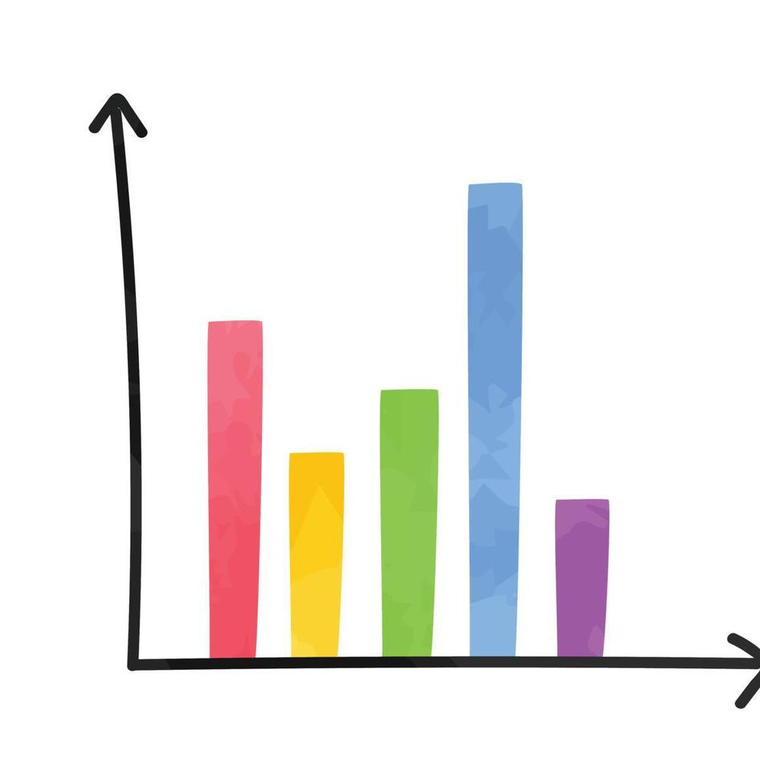
Dataset
Heart Disease Dataset, Kaggle
Size: 1,025
Features: 13 clinical attributes
Target: Binary classification
Numerical & Categorical features – original source

Slide 7

Performance Metrics
Accuracy: Overall correctness
Precision: Positive predictive value
Recall (Sensitivity): minimizing false negatives
F1-Score
ROC
Confusion Matrix

Slide 8

Questions & Discussion
Thank You

